Slide 1
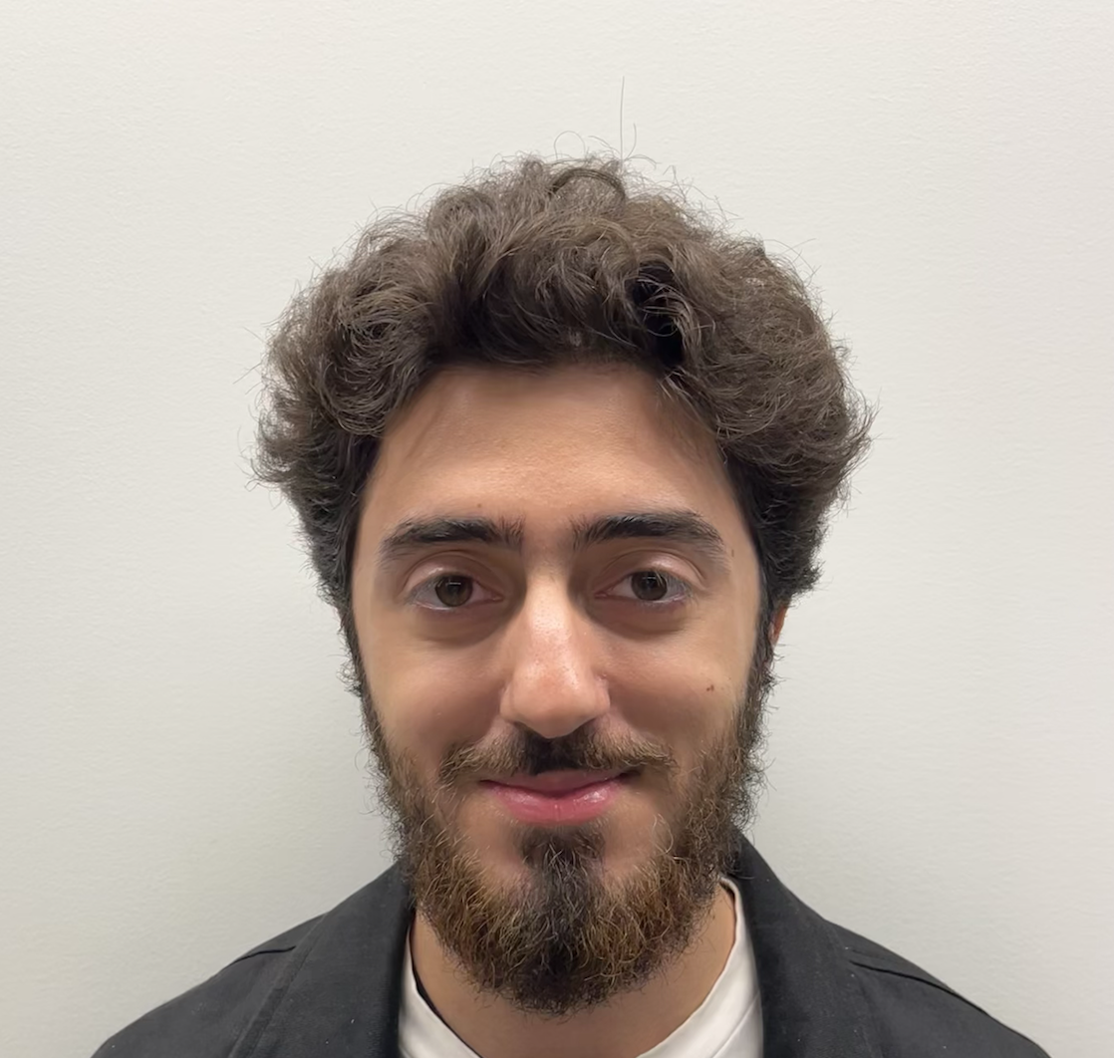


Development Update:
Team 3B
Sadra
Saleh
Junyi
Notes:
Subsystem’s Role, Design Overview, Input and Output’s

Slide 2
Table of Contents
5. Why It Works
6. Next Steps and Expected Challenges
7. Q&A
8. References
Subsystem A’s Role
Design Approach
Design Overview
Subcomponents of Design:
Bandpass Filter
Voltage limiter
Mixer
Low pass filter and IQ amplifier

Slide 3
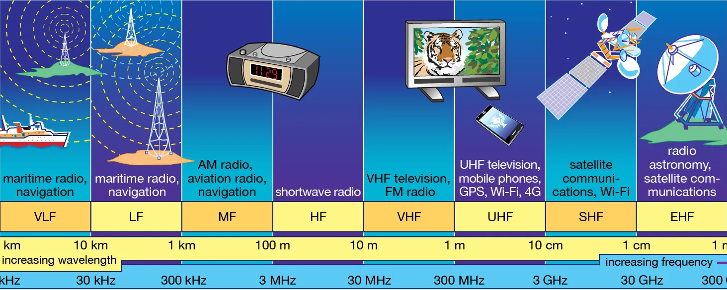
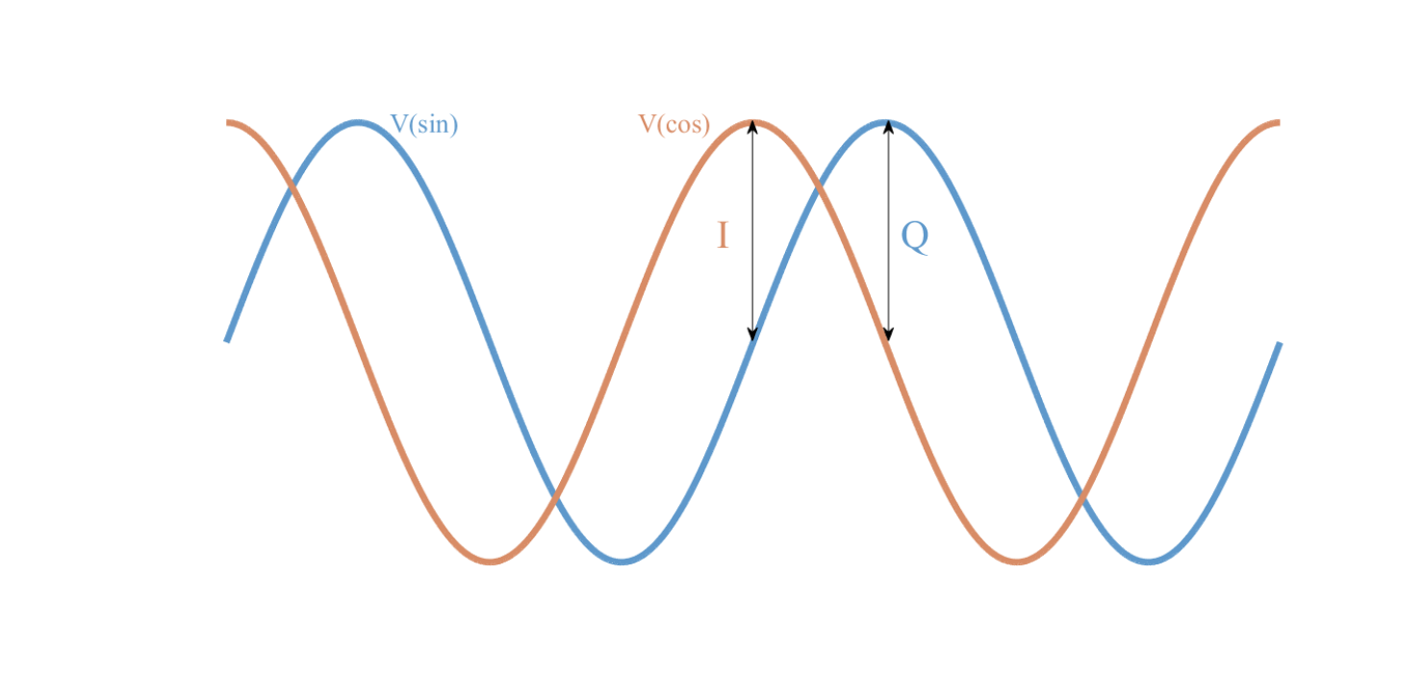
Subsystem A’s Role:
Figure 1. The radio frequency spectrum [1].
Figure 2. IQ representation of a signal [2].
Notes:
Imagine all of these presentations were happening at once. It would be impossible to understand anything with all of the information coming at you at once. Similarly a radio faces the same dilemma with all of the frequencies picked up by the antenna at the same time as shown in figure 1.

Slide 4
2. Design Approach
“Simplicity is the key to brilliance.”
-Bruce Lee
Notes:
Since we only get one opportunity to make a PCB we wanted to maximize our chances of getting the design right. In order to do this we decided to keep our designs as simple as possible. As a result our designs involve fewer components which decreases the likelihood of calculation errors, makes them easier to debug, and also minimizes the points of failure.

Slide 5
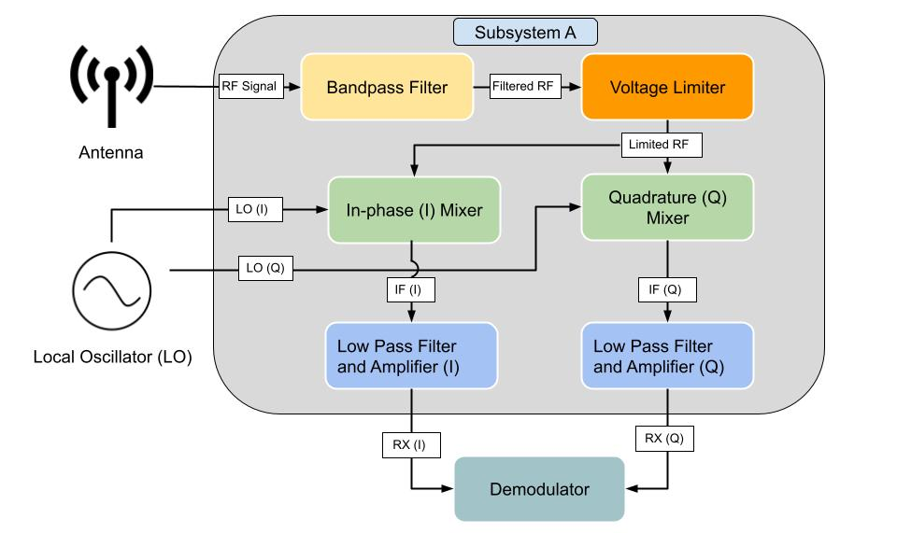
IF - Intermediate Frequency
RX - Receiver Signal
Notes:
Then put the schematic of the entire design, then explain bit by bit until we reach the end where we explain how it was tested.
Inputs outputs

Slide 6
4. Subcomponents
of Design

Slide 7
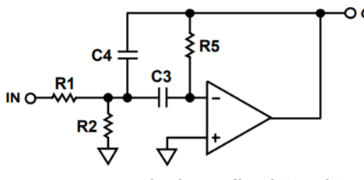
I) Bandpass Filter V1
Initial Idea: Active 5th order Chebyshev Bandpass Filter
Signal Distortion [15].
Expensive Components
14 Components
Ripple in the pass band
Figure 3. Active 2nd order Chebyshev Bandpass Filter [3].
Notes:
The bandpass filter filters the signals from the antenna which is then passed to the limiter. My initial idea was to implement the bandpass filter using an active (requires external power supply to operate) RC 5th order chebyshev bandpass filter. The Chebyshev Type was chosen for its higher selectivity compared to the other filter types. However I soon realized that the active RC implementation of the Chebyshev Filter was not feasible since the resistors would induce thermal noise on the signal which can cause distortion. Furthermore, an op amp with high bandwidth gain would be needed due to the high frequency of the signals being filtered which are quite expensive and 3 of them would be needed for the design. Lastly, perhaps the main reason why it was removed is due to the complexity of the design. The 2nd order chebyshev bandpass filter in Figure 3 requires 6 components and a 5th order filter would require 14. In addition, the design has a 1dB ripple in the passband which although minimal still leaves room for improvement. As a result I decided to make one final revision.

Slide 8
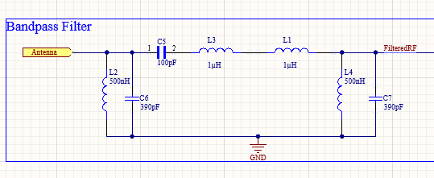
I) Bandpass Filter V2
Architecture: 3rd order LC ladder Butterworth Bandpass filter
Simple design (6 components)
No ripple in the pass band
Figure 4. 3rd order LC ladder Butterworth Bandpass Filter.
Notes:
In order to make the design simpler I used formulas to determine the order needed for a Chebyshev Bandpass LC ladder filter that would have a lower stop frequency above 1.6MHz to ensure no AM signals would pass through the filter and I calculated that a filter of order 3 will provide sufficient selectivity. In addition I decided to change the type to a Butterworth filter since I no longer required high selectivity and the Butterworth type provides a maximally flat passband gain which makes it a more suitable design considering that one of the requirements of the design is minimal ripple in the passband.

Slide 9
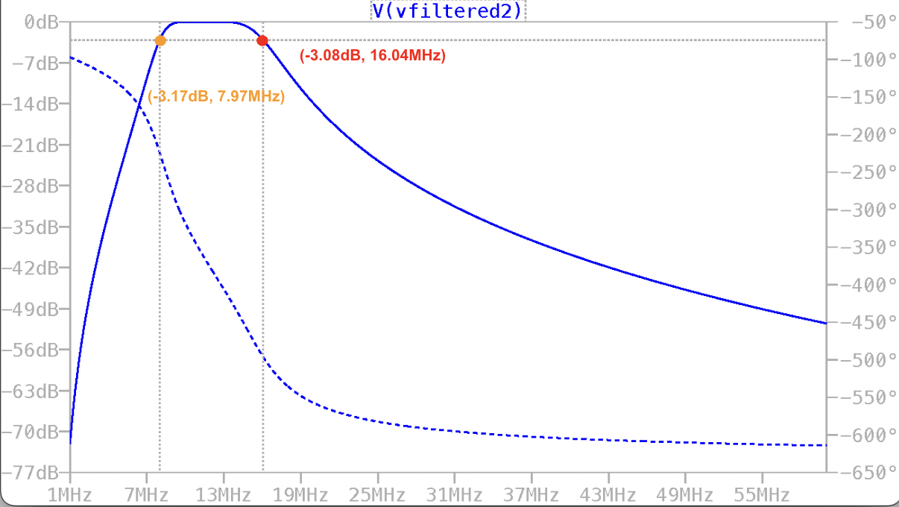
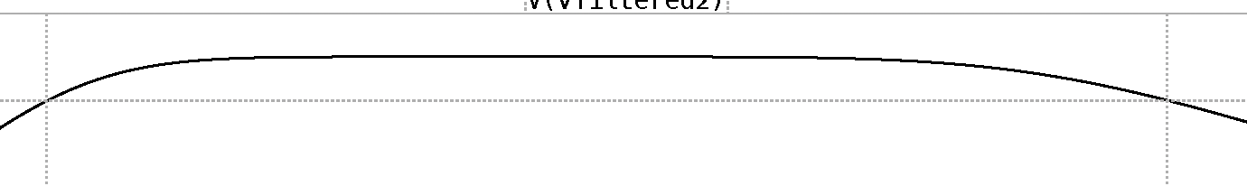
I) Bandpass Filter Simulations
Band-Pass Filter
1. 66% fractional 3 dB,
bandwidth Centered at 12 MHz
2. Maximally Flat Response (<3dB)
Figure 5. Bode plot of 3rd order LC ladder Butterworth Bandpass Filter.
Notes:
So here is the simulations of my final design. As you can see the LC ladder butterworth filter is not as selective with the gentler roll off. However it is sufficient for our needs in that it has a 3dB bandwidth from 8MHz - 16MHz. Also the zoomed in captures show the butterworth’s flat passband compared to the Chebyshev’s oscillatory passband. As a result the simpler design also does a better job of aligning with the requirements of the design.

Slide 10
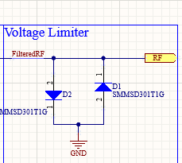
II) Voltage Limiter V1
Architecture: Anti parallel Schottky diodes configuration
“Schottky diodes are used for their […] fast recovery time and low-loss energy at higher frequencies.” [4]
Figure 6. Schematic of the voltage limiter.
Notes:
The voltage limiter then takes the filtered signal and passes it onto the I and Q mixers. For the voltage limiter since it was a fairly simple design I did not make much revisions to it other than choosing the type of diode. I chose a specific Schottky diodes that would maintain a voltage close to +-0.7Vp with varying input voltages. I chose Schottky since regular diodes would be too slow at switching and as a result would be incapable of limiting the high frequency signals coming from the antenna.

Slide 11
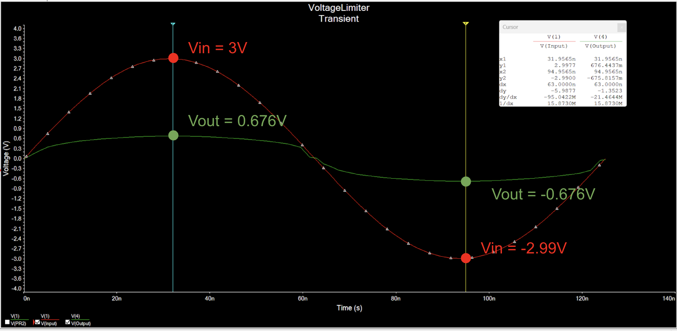
II) Voltage Limiter Simulations
Voltage Limiter
3. Clip Voltages above ±0.7V
Figure 7. Output (Green) of the voltage limiter with an input (Red) of 3Vpp.
Notes:
So here is the simulations of the voltage limiter. The limiter was tested with an input above 0.7Vp as seen in red to ensure the circuit’s functionality of limiting the output. As you can see the output is limited to roughly 677 mVp.

Slide 12
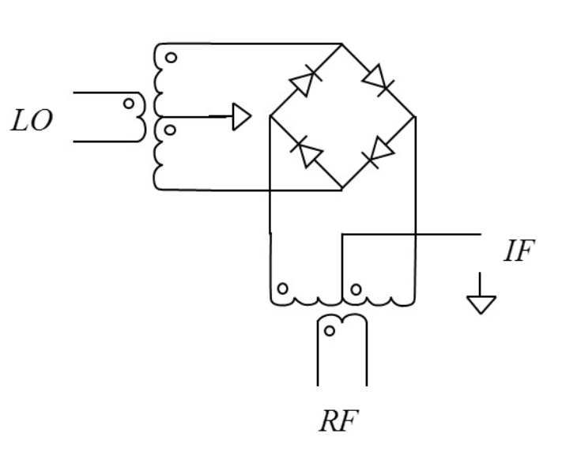
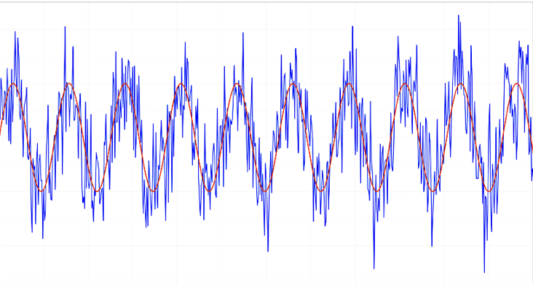
III) Mixer V1
Input interference [14]
Slower switching speed [9]
Strong RF signals
Figure 8. Schematic of Diode Ring Mixer [5].
Figure 9. Image of noisy signal[16].

Slide 13
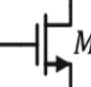
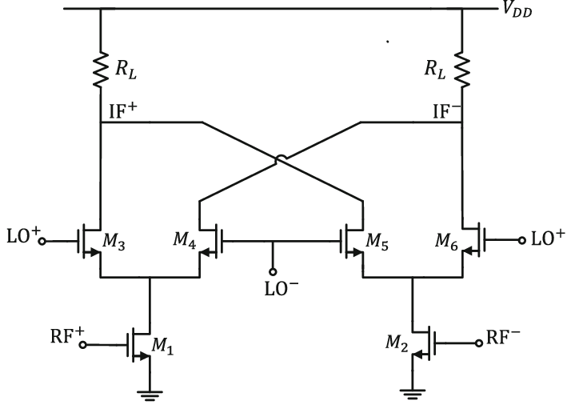
III) Mixer V2
Isolated inputs and outputs[12]
Suitable for weak RF signals [14]
Figure 10. Schematic of Gilbert Cell Mixer [6].

Slide 14
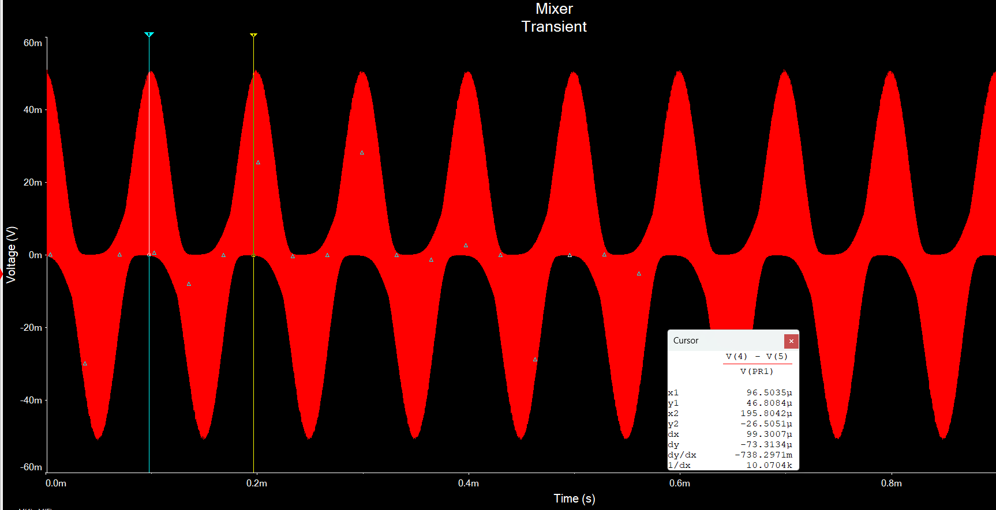
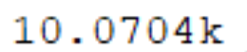
III) Mixer Simulations
Mixer
4. Centre frequency at 10KHz
5. Output signals out of phase angle < 12.5°
6. Balanced output amplitudes (<1dB)
Figure 11. Output of one mixer with 10 KHz frequency.

Slide 15
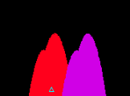
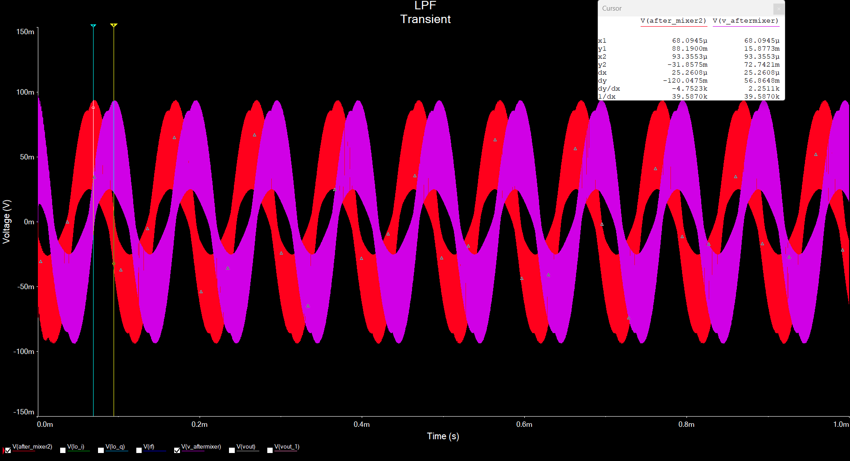


III) Mixer Simulations
Mixer
4. Centre frequency at 10KHz
5. Output signals out of phase angle < 12.5°
6. Balanced output amplitudes (<1dB)
Period = = 100 µs
100µs * = 25 µs
Figure 12. In-phase (Red) and Quadrature (Purple) outputs of the 2 mixers.

Slide 16
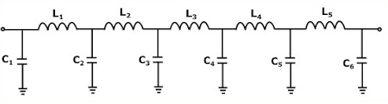
IV) Low Pass Filter and Amplifier V1
Size and cost of Inductors.
Gain and Filtering in two stages
Figure 13. Schematic of LC low pass filter [7].

Slide 17
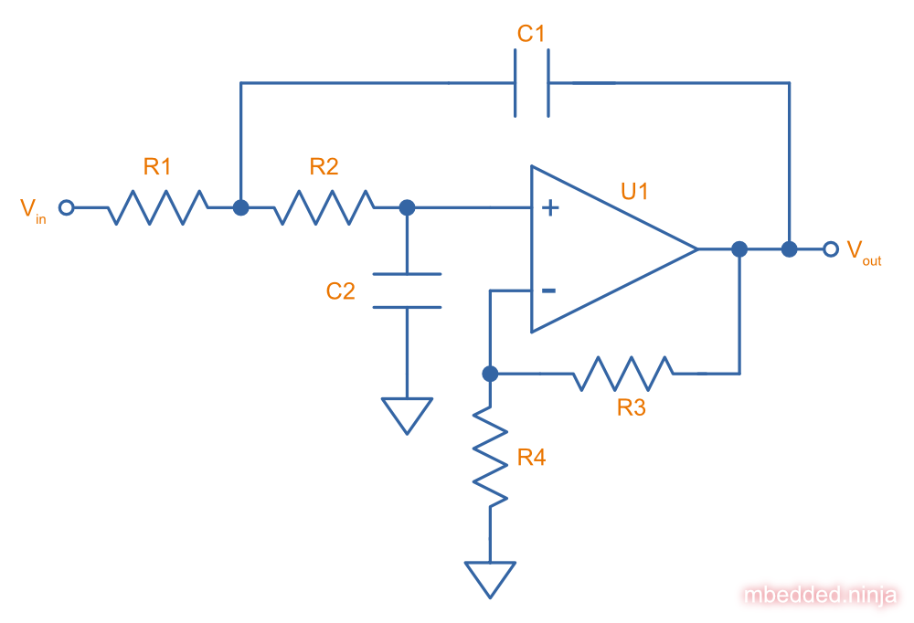

IV) Low Pass Filter and IQ Amplifier V2
Amplification and filtering in one stage
Less Components
Figure 14. Schematic of second order Sallen Key Low Pass filter with gain [8].
Notes:
I’ll be guiding you through the intricacies of our Low Pass Filter (LPF) and its integrated amplifier stage. Initially, drawing parallels with Bandpass Filters (BPF), our design approach considered utilizing an RLC circuit complemented by an operational amplifier. This traditional path seemed promising, aiming to leverage the similarities in design principles and execution. However, an insightful lecture highlighted a pivotal strategy: the utilization of an active low pass filter could elegantly fulfill both the roles of LPF and amplifier.
(showing the schematics of active LPF without DC offset)
It takes inputs from the mixer and goes to subsystem B, demodulation.
…
(showing the simulation)
As you can see, our design fulfills the requirement by having a cutoff frequency at 96kHz and a gain of 30dB.

Slide 18
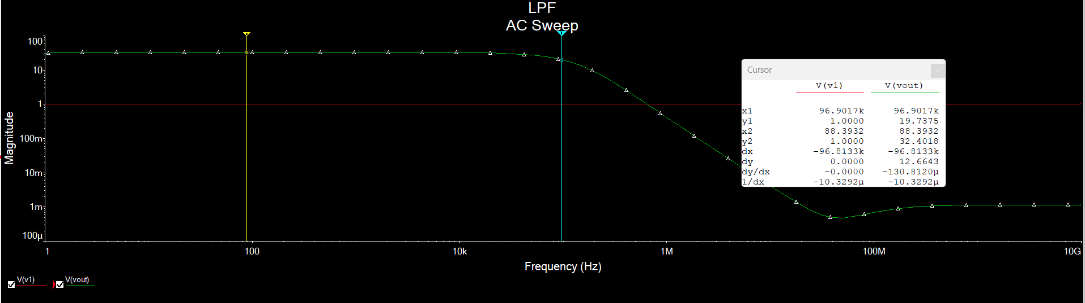
IV) LPF and Amplifier - Simulation
Low-Pass Filter & Amplifier
7. Signal amplification (30dB)
8. Signal filtering (96KHz)
9. Output voltage (0-5V)
Figure 15. AC Sweep Frequency Response of a Low Pass Filter

Slide 19
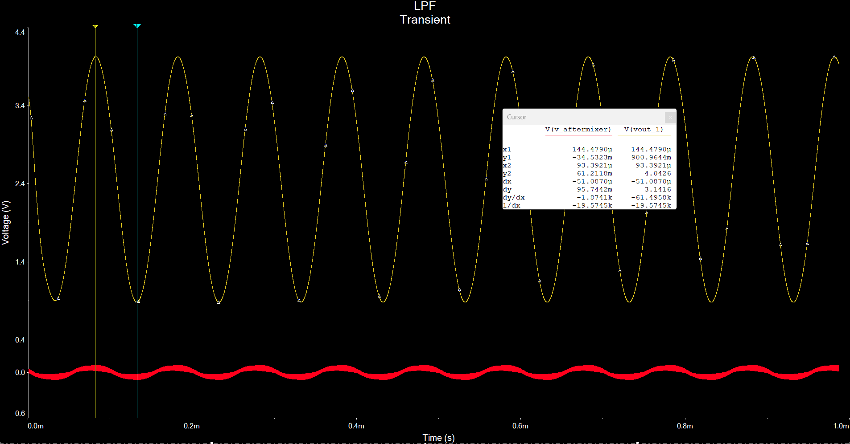
IV) LPF and Amplifier Simulation
Low-Pass Filter & Amplifier
7. Signal amplification (30dB)
8. Signal filtering (96KHz)
9. Output voltage (0-5V)
Gain
dB
Figure 16. Transient response of mixer input signal

Slide 20
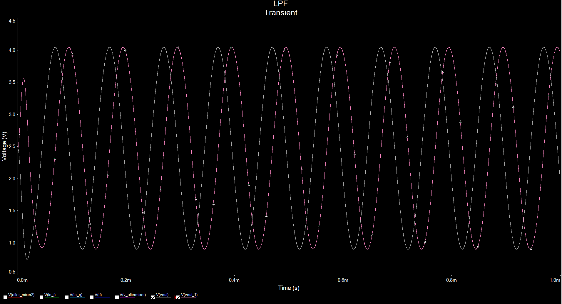
5. Why It Works
Figure 17. Simulation of the entire system, outputs of I and Q Signals (Grey and Purple respectively).
Figure 18. IQ representation of a signal [2].
Notes:
We already simulated all parts individually and together on multisim and they function as required. The design is also simple and easy to implement.
Our designs are kept as simple as possible.

Slide 21

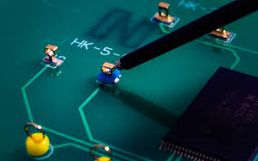
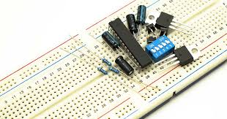
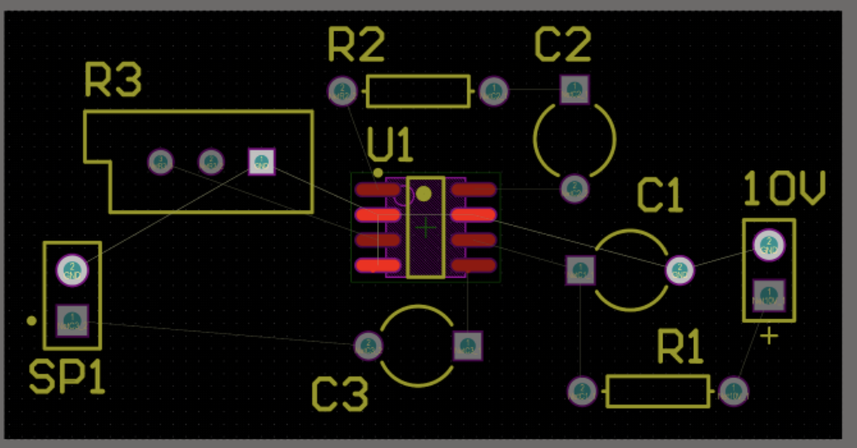
6. Next Steps & Expected Challenges
Week 7
Week 8
Week 9
Week 10
Protoboarding
Layout
Testing Procedure & Soldering
Testing and Debugging
Figure 19. Image of protoboard and discrete components [10].
Figure 20. Layout of a Print Circuit Board on altium [11].
Figure 21. Testing procedure [12].
Figure 22. Image of test points on a Printed Circuit Board [13].

Slide 22
7. Q & A

Slide 23
8. References
[1]“Spectrum,” Encyclopædia Britannica, https://www.britannica.com/science/spectrum (accessed Feb. 27, 2024).
[2] F. Talebi, “An introduction to I/Q signals,” Short & Medium Range Radars for Training and Civil Aviation, https://www.skyradar.com/blog/an-introduction-to-i/q-signals (accessed Feb. 25, 2024).
[3] A. L., “Active filters: 2nd order Tschebychev Bandpass,” MisCircuitos.com, https://miscircuitos.com/active-filters-2nd-order-tschebychev-bandpass/ (accessed Feb. 25, 2024).
[4] “Schottky diode characteristics and applications,” Wolfspeed, https://www.wolfspeed.com/knowledge-center/article/schottky-diode-characteristics-and-applications/ (accessed Feb. 25, 2024).
[5]“Double balanced mixer theory,” David S. Ricketts, https://rickettslab.org/bits2waves/design/mixer-discrete/mixer-discrete-theory/ (accessed Feb. 27, 2024).
[6] Conventional double-balanced Gilbert-cell mixer. | download ..., https://www.researchgate.net/figure/Conventional-double-balanced-Gilbert-cell-mixer_fig1_276348124 (accessed Feb. 27, 2024).

Slide 24
8. References
[7] Chebyshev PI LC low pass filter calculator, http://www.calculatoredge.com/electronics/ch%20pi%20low%20pass.htm (accessed Feb. 27, 2024).
[8] G. Hunter and Geoffrey HunterDude making stuff. Twitter GitHubkofiwidget2.init(“Support Me on Ko-fi,” “Sallen-key filters,” mbedded.ninja, https://blog.mbedded.ninja/electronics/circuit-design/analogue-filters/sallen-key-filters/ (accessed Feb. 27, 2024).
[9] “What is the difference between diode and transistor?,” ELECTRICAL TECHNOLOGY, https://www.electricaltechnology.org/2021/04/difference-diode-transistor.html (accessed Feb. 27, 2024).
[10] “Radio components lie on model payment stock photo 1062465068,” Shutterstock, https://www.shutterstock.com/image-photo/radio-components-lie-on-model-payment-1062465068 (accessed Feb. 25, 2024).
[11] “Learn how to design PCBS with the best PCB layout tutorials,” Altium, https://resources.altium.com/p/pcb-layout-tutorial (accessed Feb. 27, 2024).

Slide 25
8. References
[12] C. Hall, “Test of details: Substantive audit procedure,” CPA Hall Talk, https://cpahalltalk.com/test-of-details/ (accessed Feb. 27, 2024).
[13] Chris, “What is a PCB test point and why is it important?,” Jamindo PCBA, https://jamindopcba.com/pcb-test-point/ (accessed Feb. 25, 2024).
[14] S. Mehta, X. J. Li, and M. Donelli, “Recent advancement in the design of Mixers for software‐defined radios,” International Journal of RF and Microwave Computer-Aided Engineering, vol. 32, no. 2, Nov. 2021. doi:10.1002/mmce.22963
[15] A. S. Sanchita Sarkar, “Different types of noise in RF devices,” Rahsoft, https://rahsoft.com/2021/05/10/different-types-of-noise-in-rf-devices/#:~:text=Noise%20in%20Resistor%3A%20The%20kind,moving%20randomly%20and%20produces%20noise. (accessed Feb. 27, 2024).
[16] [1] A. Kejariwal and M. Daoudi, “Signal Processing: Filtering out the noise,” RSS, https://www.catchpoint.com/blog/signal-vs-noise (accessed Feb. 27, 2024).

